Slide 1



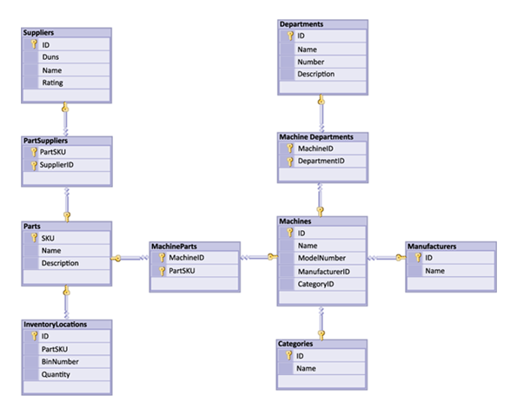


Basic CRUD in MySQL Server
Create, Retrieve, Update, Delete
using SQL queries
Basic
CRUD
SoftUni Team
Technical Trainers
Software University
http://softuni.bg

Slide 2

Table of Contents
Query Basics
Retrieving Data
Writing Data
Modifying Existing Records

Slide 3
Questions
sli.do #MYSQL

Slide 4


Query Basics
SQL Introduction

Slide 5
What is SQL?
Structured Query Language (SQL) – en.wikipedia.org/wiki/SQL
Declarative language for working with relational data
Meant to be as close to regular English as possible
Supports definition, manipulation and access control of records

Slide 6
SQL – Few Examples
SELECT first_name, last_name, job_title FROM employees;
SELECT * FROM projects WHERE start_date='2003-06-01';
INSERT INTO projects(name, start_date)
VALUES('Introduction to SQL Course', '2006-01-01');
UPDATE projects
SET end_date = '2006-08-31'
WHERE start_date = '2006-01-01';
DELETE FROM projects
WHERE start_date = '2006-01-01';

Slide 7

Retrieving Data
Using SQL SELECT

Slide 8
Capabilities of SQL SELECT
Projection
Take a subset of the columns
Selection
Take a subset of the rows
Join
Combine tables by
some column
Table 1
Table 2
Notes:
Capabilities of SQL SELECT Statements
A SELECT statement retrieves information from the database. Using a SELECT statement, you can do the following:
Projection: You can use the projection capability in SQL to choose the columns in a table that you want returned by your query. You can choose as few or as many columns of the table as you require.
Selection: You can use the selection capability in SQL to choose the rows in a table that you want returned by a query. You can use various criteria to restrict the rows that you see.
Joining: You can use the join capability in SQL to bring together data that is stored in different tables by creating a link between them. You learn more about joins in a later lesson.

Slide 9
SELECT – Example
Selecting all columns from the "departments" table
Selecting specific columns
SELECT * FROM departments;
department_id | name | manager_id
1 | Engineering | 12
2 | Tool design | 4
3 | Sales | 273
… | … | …
List of columns
(* for everything)
Table name
department_id | name
1 | Engineering
2 | Tool design
3 | Sales
… | …
SELECT department_id, name
FROM departments
Notes:
Selecting All Columns of All Rows
You can display all columns of data in a table by following the SELECT keyword with an asterisk (*). In the example on the slide, the department table contains five columns: DepartmentID, Name, GroupName, ModifiedDate and rowguid. The table contains 16 rows, one for each department.
You can also display all columns in the table by listing all the columns after the SELECT keyword. For example, the following SQL statement, like the example on the slide, displays all columns and all rows of the Departments table:
SELECT DepartmentID, Name, GroupName, ModifiedDate, rowguid
FROM department;
Selecting Specific Columns of All Rows
You can use the SELECT statement to display specific columns of the table by specifying the column names, separated by commas. The example on the slide displays all the department numbers and location numbers from the Departments table.
In the SELECT clause, specify the columns that you want, in the order in which you want them to appear in the output. For example, to display location before department number going from left to right, you use the following statement:
SELECT DepartmentID, Name
FROM Departments

Slide 10
Column Aliases
Aliases rename a table or a column heading
You can shorten fields or clarify abbreviations
SELECT employee_id AS id, first_name, last_name
FROM employees;
Display name
id | first_name | last_name
1 | Guy | Gilbert
2 | Kevin | Brown
… | … | …
SELECT c.duration,
c.acg AS 'Access Control Gateway'
FROM calls AS c;
Notes:
Column Aliases
When displaying the result of a query, SQL Query Analyzer normally uses the name of the selected column as the column heading. For calculations the value usually is “(No column name)”. This heading is not descriptive and hence may be difficult to understand. You can change a column heading by using a column alias.
Specify the alias after the column in the SELECT list using a space as a separator. If the alias contains spaces or special characters (such as # or $), enclose the alias in double quotation marks (" ").

Slide 11
Concatenation
You can concatenate column names or strings using the concat() function
String literals are enclosed in ['](single quotes)
Table and column names containing special symbols use [`] (backtick)
SELECT concat(`first_name`,' ',`last_name`) AS 'Full Name',
`employee_id` AS `No.`
FROM `employees`;
Full Name | No.
Guy Gilbert | 1
Kevin Brown | 2
… | …
Notes:
Concatenation Operator
You can link columns to other columns, arithmetic expressions, or constant values to create a character expression by using the concatenation operator (+). Columns on either side of the operator are combined to make a single output column.
In the example, FirstName and LastName are concatenated, and they are given the alias FullName. Notice that the employee first name and last name are combined to make a single output column.
The AS keyword before the alias name makes the SELECT clause easier to read.

Slide 12
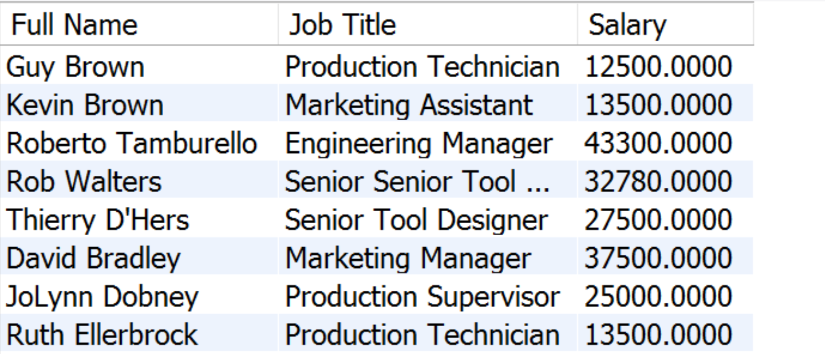
Problem: Employee Summary
Find information about all employees, listing their full name, job title and salary
Use concatenation to display first and last names as one field
Note: Query SoftUni database

Slide 13
Solution: Employee Summary
Concatenation
SELECT
CONCAT(`first_name`,' ',`last_name`) AS 'Full Name',
`job_title` AS 'Job Title',
`salary` AS 'Salary'
FROM `employees`;
Column alias

Slide 14
Filtering the Selected Rows
Use DISTINCT to eliminate duplicate results
You can filter rows by specific conditions using the WHERE clause
Other logical operators can be used for greater control
SELECT DISTINCT `department_id`
FROM `employees`;
SELECT `last_name`, `department_id`
FROM `employees`
WHERE `department_id` = 1;
SELECT `last_name`, `salary`
FROM `employees`
WHERE `salary` <= 20000;
Notes:
In the example, the SELECT statement retrieves the name and department number of all employees whose department is 1.
Character strings and dates in the WHERE clause must be enclosed in single quotation marks (''). Number constants, however, should not be enclosed in single quotation marks.

Slide 15
Other Comparison Conditions
Conditions ca be combined using NOT, OR, AND and brackets
Using BETWEEN operator to specify a range:
Using IN / NOT IN to specify a set of values:
SELECT `last_name` FROM `employees`
WHERE NOT (`manager_id` = 3 OR `manager_id` = 4);
SELECT `last_name`, `salary`FROM `employees`
WHERE `salary` BETWEEN 20000 AND 22000;
SELECT `first_name`, `last_name`, `manager_id`
FROM `employees`
WHERE `manager_id` IN (109, 3, 16);
Notes:
The BETWEEN Condition
You can display rows based on a range of values using the BETWEEN range condition. The range that you specify contains a lower limit and an upper limit.
The SELECT statement on the slide returns rows from the Employees table for any employee whose base rate is between 40 and 50.
Values specified with the BETWEEN condition are inclusive. You must specify the lower limit first.
The IN Condition
To test for values in a specified set of values, use the IN condition. The IN condition is also known as the membership condition.
The LIKE Condition
You may not always know the exact value to search for. You can select rows that match a character pattern by using the LIKE condition. The character pattern-matching operation is referred to as a wildcard search. Two symbols can be used to construct the search string.
Search conditions can contain either literal characters or numbers:
% denotes zero or many characters.
_ denotes one character.

Slide 16
Comparing with NULL
NULL is a special value that means missing value
Not the same as 0 or a blank space
Checking for NULL values
This is always false!
SELECT `last_name`, `manager_id`
FROM `employees`
WHERE `manager_id` = NULL;
SELECT `last_name`, `manager_id`
FROM `employees`
WHERE `manager_id` IS NULL;
SELECT `last_name`, `manager_id`
FROM `employees`
WHERE `manager_id` IS NOT NULL;
Notes:
Null Values
If a row lacks the data value for a particular column, that value is said to be null, or to contain a null.
A null is a value that is unavailable, unassigned, unknown, or inapplicable. A null is not the same as zero or a space. Zero is a number, and a space is a character.
Columns of any data type can contain nulls. However, some constraints, NOT NULL and PRIMARY KEY, prevent nulls from being used in the column.
In the ManagerID column in the Employees table, notice that managers (like Sanchez) have no ManagerID.
If any column value in an arithmetic expression is null, the result is null. For example, if you attempt to perform division with zero, you get an error. However, if you divide a number by null, the result is a null or unknown.

Slide 17

Sorting with ORDER BY
Sort rows with the ORDER BY clause
ASC: ascending order, default
DESC: descending order
LastName | HireDate
Gilbert | 1998-07-31
Brown | 1999-02-26
Tamburello | 1999-12-12
… | …
SELECT `last_name`, `hire_date`
FROM `employees`
ORDER BY `hire_date`;
LastName | HireDate
Valdez | 2005-07-01
Tsoflias | 2005-07-01
Abbas | 2005-04-15
… | …
SELECT `last_name`, `hire_date`
FROM `employees`
ORDER BY `hire_date` DESC;
Notes:
The ORDER BY Clause
The order of rows returned in a query result is undefined. The ORDER BY clause can be used to sort the rows. If you use the ORDER BY clause, it must be the last clause of the SQL statement. You can specify an expression, or an alias, or column position as the sort condition.

Slide 18
Views
Views are virtual tables made from others tables, views or joins between them
Can be used to simplify writing of complex queries or to limit access to data for certain users
Examples: Get employee names and salaries, by department
CREATE VIEW `v_hr_result_set` AS SELECT
CONCAT(`first_name`,' ',`last_name`) AS 'Full Name', `salary`
FROM `employees` ORDER BY `department_id`;
SELECT * FROM `v_hr_result_set`;

Slide 19
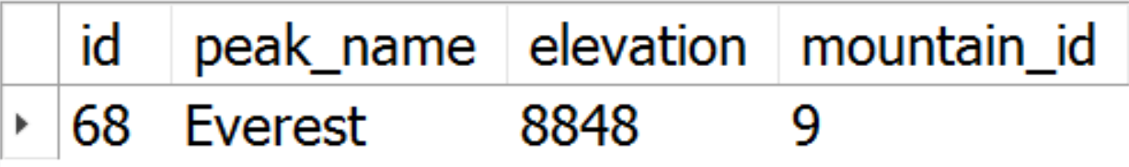
Problem: Highest Peak
Create a view that selects all information about the highest peak
Name the view v_highest_peak
Note: Query Geography database
SELECT * FROM `v_highest_peak`;

Slide 20
Solution: Highest Peak
CREATE VIEW `v_highest_peak`
AS
SELECT * FROM `peaks`
ORDER BY `elevation` DESC LIMIT 1;
Sorting column
Greatest value first

Slide 21



Writing Data in Tables
Using SQL INSERT

Slide 22
Inserting Data
Values for
all columns
The SQL INSERT command
Bulk data can be recorded in a single query, separated by comma
INSERT INTO `towns` VALUES (33, 'Paris');
Specify
columns
INSERT INTO projects(`name`, `start_date`)
VALUES ('Reflective Jacket', NOW())
INSERT INTO `employees_projects`
VALUES (229, 1),
(229, 2),
(229, 3), …

Slide 23
Inserting Data (2)
You can use existing records to create a new table
Or into an existing table
New table name
CREATE TABLE `customer_contacts`
AS SELECT `customer_id`, `first_name`, `email`, `phone`
FROM `customers`;
Existing source
List of columns
INSERT INTO projects(name, start_date)
SELECT CONCAT(name,' ', ' Restructuring'), NOW()
FROM departments;

Slide 24

Modifying Existing Records
Using SQL UPDATE and DELETE

Slide 25
Deleting Data
Condition
Deleting specific rows from a table
Note: Don’t forget the WHERE clause!
Delete all rows from a table (works faster than DELETE)
DELETE FROM `employees`
WHERE `employee_id` = 1;
TRUNCATE TABLE users;

Slide 26
Updating Data
The SQL UPDATE command
Note: Don’t forget the WHERE clause!
New values
UPDATE `employees`
SET `last_name` = 'Brown'
WHERE `employee_id` = 1;
UPDATE `employees`
SET `salary` = `salary` * 1.10,
`job_title` = CONCAT('Senior',' ', `job_title`)
WHERE `department_id` = 3;

Slide 27
Problem: Update Projects
Mark all unfinished Projects as being completed today
Hint: Unfinished projects have their end_date set to NULL
Note: Query SoftUni database
name | end_date
Classic Vest | NULL
HL Touring Frame | NULL
LL Touring Frame | NULL
… | …
name | end_date
Classic Vest | 2017-05-29
HL Touring Frame | 2017-05-29
LL Touring Frame | 2017-05-29
… | …

Slide 28
Solution: Update Projects
UPDATE `projects`
SET `end_date` = '2017-05-29'
WHERE `end_date` IS NULL;
Filter only records
with no value

Slide 29


Summary
SQL is the language of MySQL Server
Queries provide a flexible and powerful method to manipulate records
SELECT *
FROM `projects`
WHERE `start_date` = '2006-01-01';

Slide 30







Basic CRUD in MySQL Server
https://softuni.bg/courses/

Slide 31
License
This course (slides, examples, demos, videos, homework, etc.) is licensed under the "Creative Commons Attribution-NonCommercial-ShareAlike 4.0 International" license
Attribution: this work may contain portions from
"Databases" course by Telerik Academy under CC-BY-NC-SA license

Slide 32




Free Trainings @ Software University
Software University Foundation – softuni.org
Software University – High-Quality Education, Profession and Job for Software Developers
softuni.bg
Software University @ Facebook
facebook.com/SoftwareUniversity
Software University Forums
forum.softuni.bg

